Slide 1

Quantum Reality from Late Time Boundary Conditions: Problems and Possibilities
Adrian Kent
(Centre for Quantum Information and Foundations, DAMTP, University of Cambridge
and Perimeter Institute for Theoretical Physics)
Conceptual Foundations of QFT Workshop
ӦAW, Vienna
June 3, 2026

Slide 2
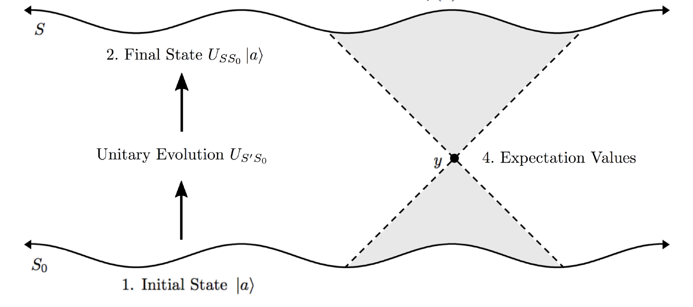
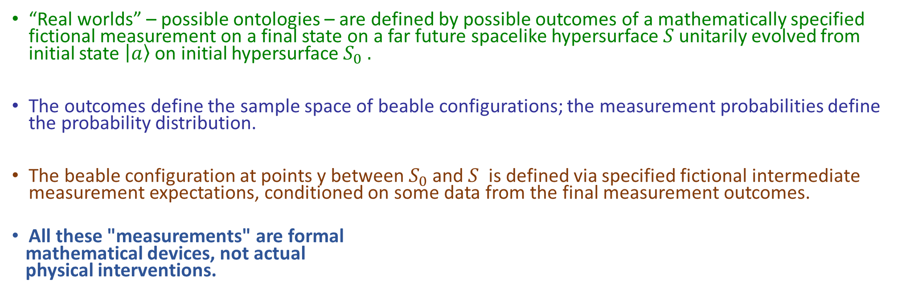
“Real world interpretations” of quantum theory
(AK Found. Phys. 42, 3 (2012), arXiv:0708.3710 (2007); Phil. Trans. R. Soc. A 373: 20140241 (2014);
Phys. Rev. A 96, 062121 (2017), arXiv:1608.04805; Butterfield, J., & Marsh, B. (2019). Journal of Physics: Conference Series, 1275, Article 1; also work in progress)
“Real worlds” – possible ontologies – are defined by possible outcomes of a mathematically specified fictional measurement on a final state on a far future spacelike hypersurface $S$unitarily evolved from initial state $\left|a\right\rangle$on initial hypersurface $S_{0} .$
The outcomes define the sample space of beable configurations; the measurement probabilities define the probability distribution.
The beable configuration at points y between $S_{0}$ and $S$ is defined via specified fictional intermediate measurement expectations, conditioned on some data from the final measurement outcomes.
All these "measurements" are formal
mathematical devices, not actual
physical interventions.
fictional measurement on S
from fictional measurement at y
Thanks to Jeremy Butterfield
and Brendan Marsh for diagram

Slide 3
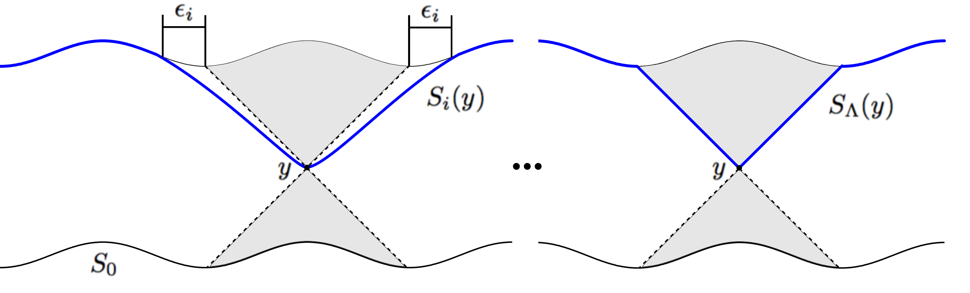
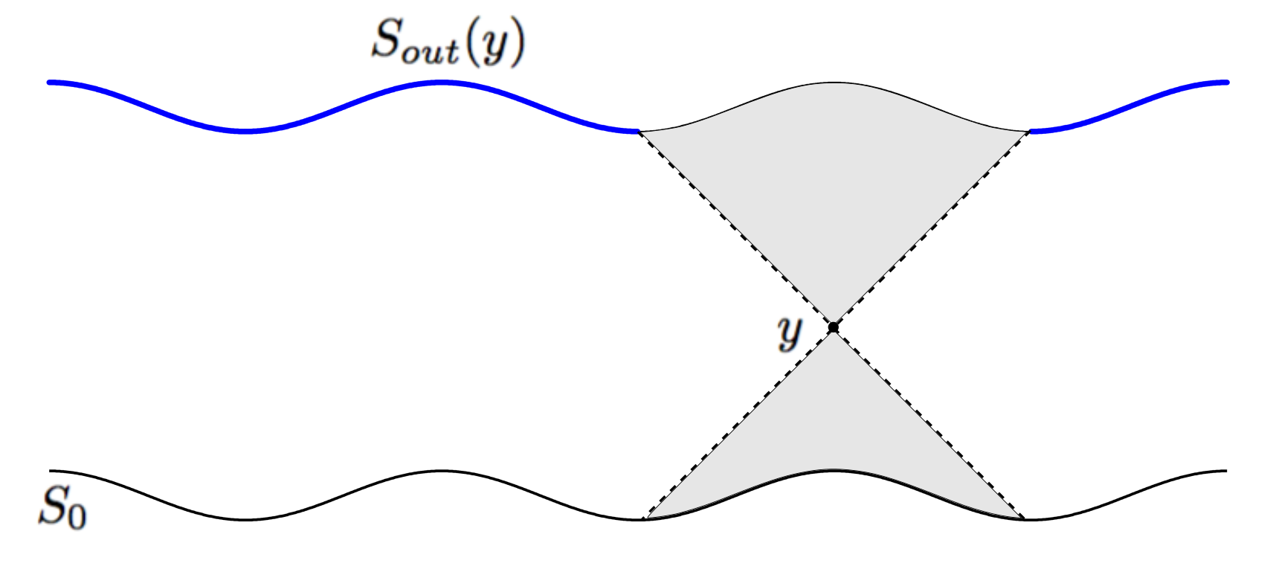
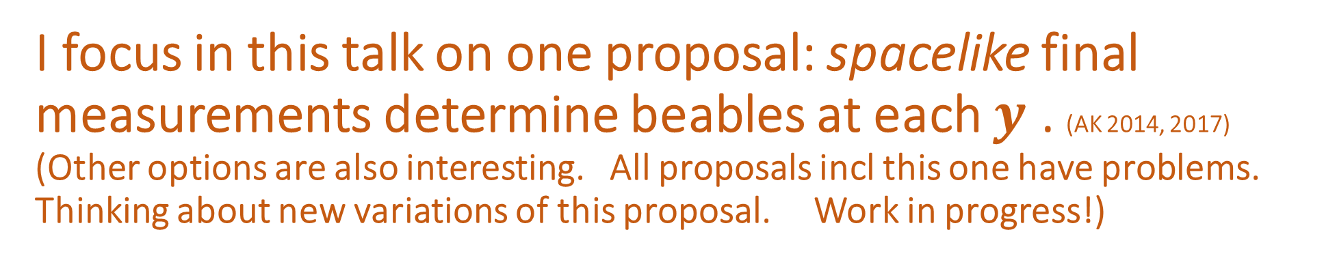
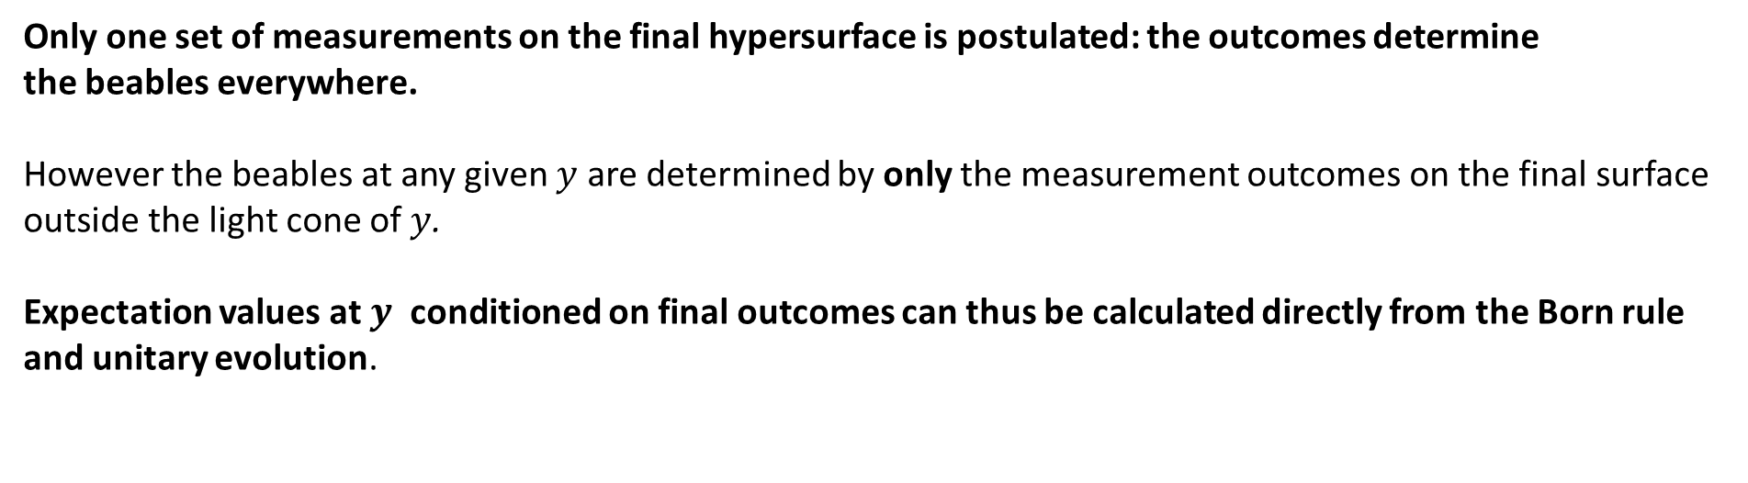
I focus in this talk on one proposal: spacelike final measurements determine beables at each $y$ . (AK 2014, 2017)
(Other options are also interesting. All proposals incl this one have problems.
Thinking about new variations of this proposal. Work in progress!)
Only one set of measurements on the final hypersurface is postulated: the outcomes determine
the beables everywhere.
However the beables at any given $y$ are determined by only the measurement outcomes on the final surface
outside the light cone of $y$.
Expectation values at $y$ conditioned on final outcomes can thus be calculated directly from the Born rule
and unitary evolution.
Thanks to Jeremy Butterfield and
Brendan Marsh for diagrams
Born rule applied on each $S_{i} \left(y\right)$, in limit as $S_{i}\left(y\right)→S_{Λ}\left(y\right)$ , gives distribution on $S_{out} \left(y\right)$

Slide 4

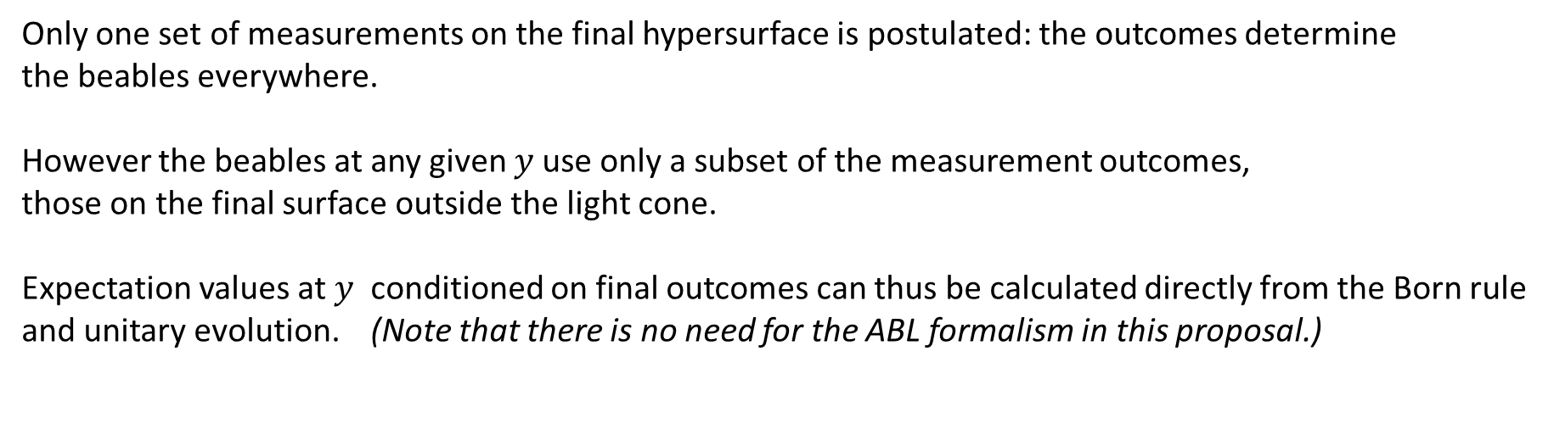
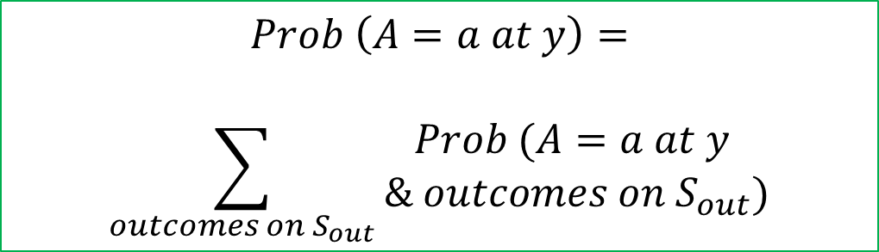
Proposal: spacelike final measurements determine beables at each $y$ (AK 2014, 2016)
Only one set of measurements on the final hypersurface is postulated: the outcomes determine
the beables everywhere.
However the beables at any given $y$use only a subset of the measurement outcomes,
those on the final surface outside the light cone.
Expectation values at $y$ conditioned on final outcomes can thus be calculated directly from the Born rule
and unitary evolution. (Note that there is no need for the ABL formalism in this proposal.)
$$Prob \left(A=a at y\right)=$$
$$\sum_{outcomes on S_{out}}{\begin{aligned}Prob (A=a at y \\ && outcomes on S_{out})\end{aligned}}$$
Thanks to Jeremy Butterfield and
Brendan Marsh for diagram

Slide 5

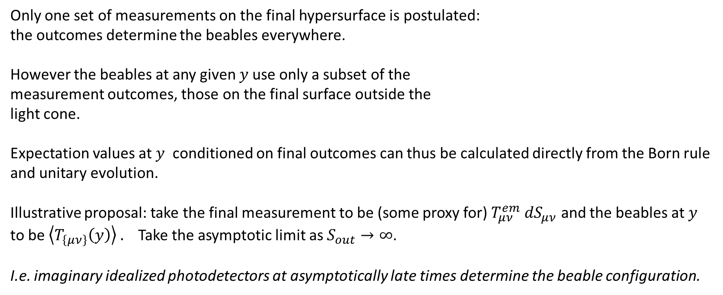
Proposal: spacelike final measurements determine beables at each$y$
Only one set of measurements on the final hypersurface is postulated:
the outcomes determine the beables everywhere.
However the beables at any given $y$use only a subset of the
measurement outcomes, those on the final surface outside the
light cone.
Expectation values at $y$ conditioned on final outcomes can thus be calculated directly from the Born rule
and unitary evolution.
Illustrative proposal: take the final measurement to be (some proxy for) $T_{μν}^{em} dS_{μν}$ and the beables at $y$
to be $\left\langle T_{\left\{μν\right\}}\left(y\right)\right\rangle .$Take the asymptotic limit as $S_{out}→∞$.
I.e. imaginary idealized photodetectors at asymptotically late times determine the beable configuration.
Thanks to Jeremy Butterfield
and Brendan Marsh for diagram

Slide 6


Asymptotic hypothesis
Hypothesis: the probability distribution on beable configurations converges to a limit as S tends to future infinity.
This limiting distribution defines the probability measure on beable configurations.
$$∞$$
$$∞$$
fictional measurement on S
from fictional measurement at y
Thanks to Jeremy Butterfield and Brendan Marsh for diagram

Slide 7
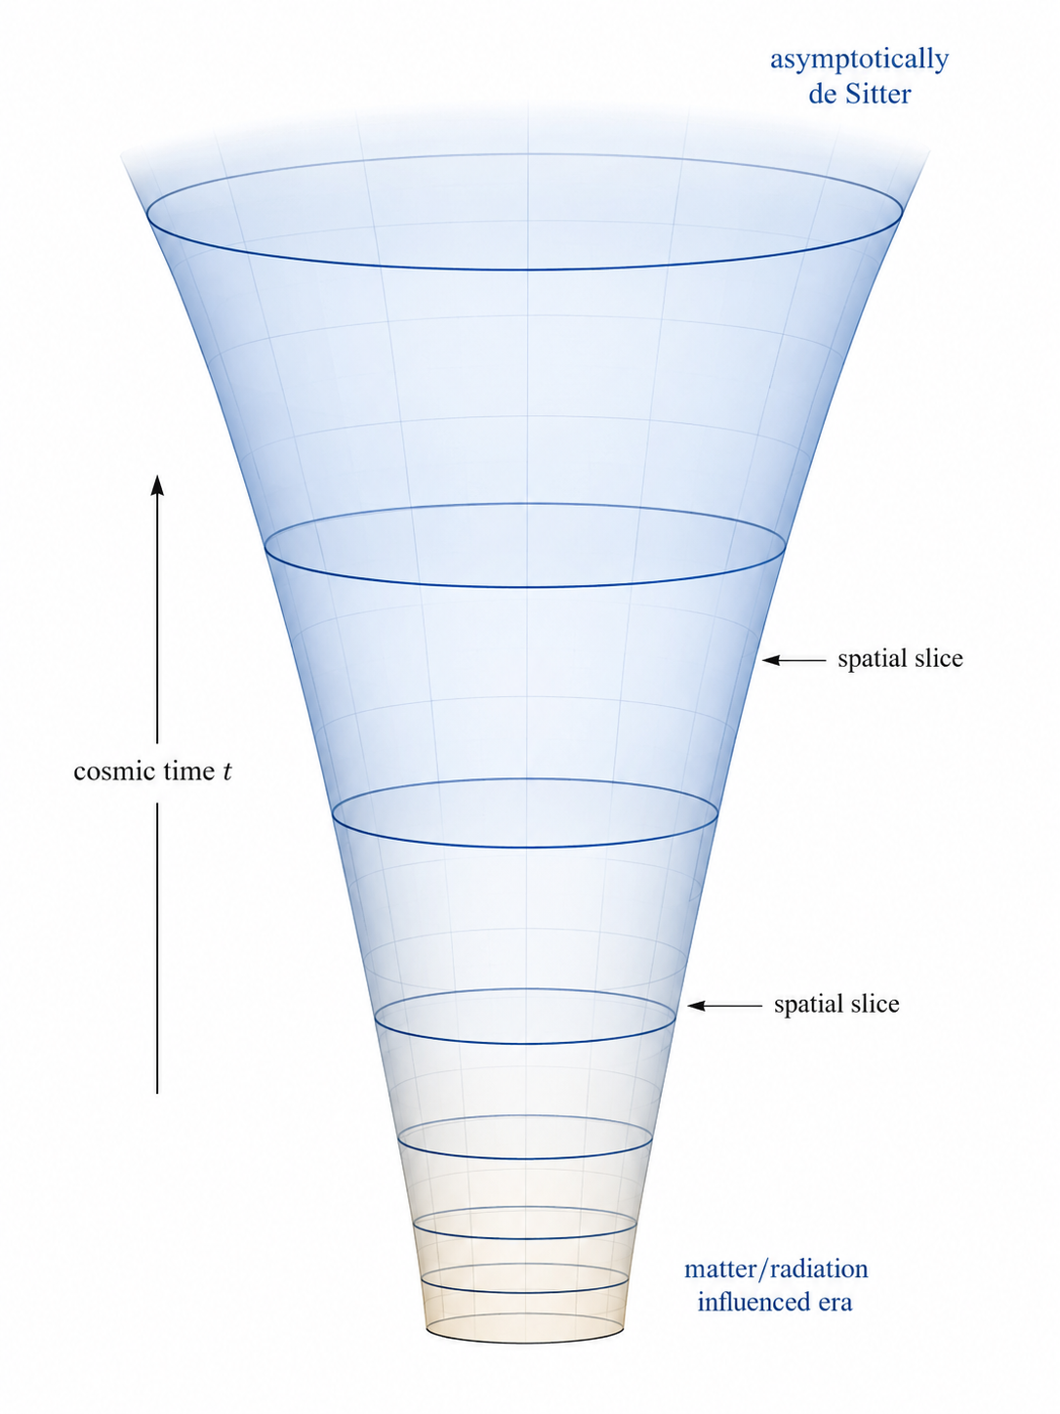
Are our asymptotic assumptions reasonable?
Consistent with standard cosmological intuitions -- interactions become sparser and sparser as the universe expands forever, and late universe photons propagate essentially freely.
They are also consistent with the intuition that quantum field theory can best be understood as defining asymptotic scattering amplitudes.
There are cosmological scenarios (for example "big crunch" models) in which they may fail.
Image: ChatGPT

Slide 8


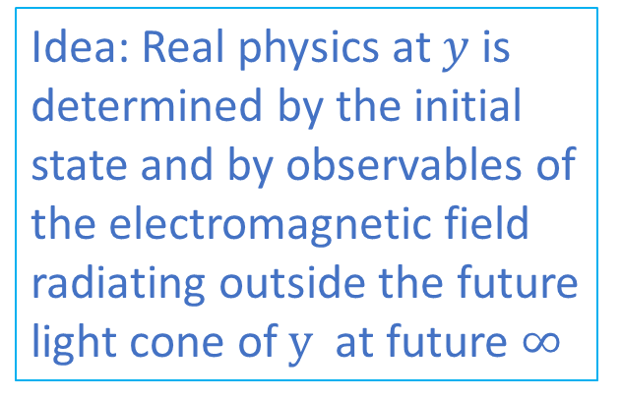
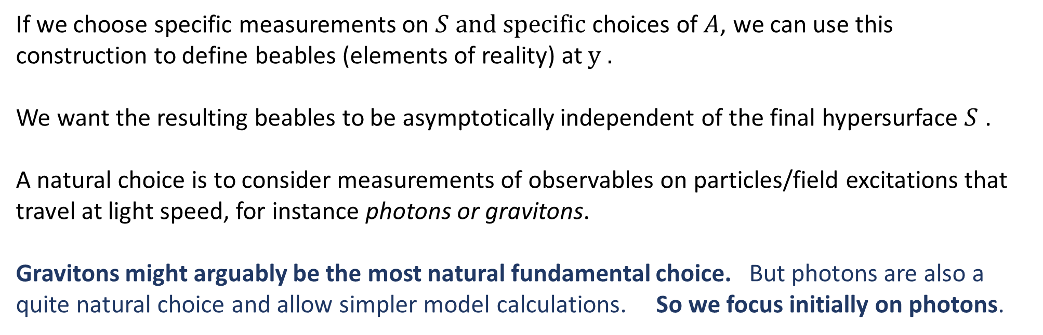




If we choose specific measurements on $S and specific$ choices of$A$, we can use this construction to define beables (elements of reality) at $y .$
We want the resulting beables to be asymptotically independent of the final hypersurface $S$ .
A natural choice is to consider measurements of observables on particles/field excitations that travel at light speed, for instance photons or gravitons.
Gravitons might arguably be the most natural fundamental choice. But photons are also a quite natural choice and allow simpler model calculations. So we focus initially on photons.
Idea: Real physics at $y$ is determined by the initial state and by observables of the electromagnetic field radiating outside the future light cone of $y$at future $∞$
y

Slide 9
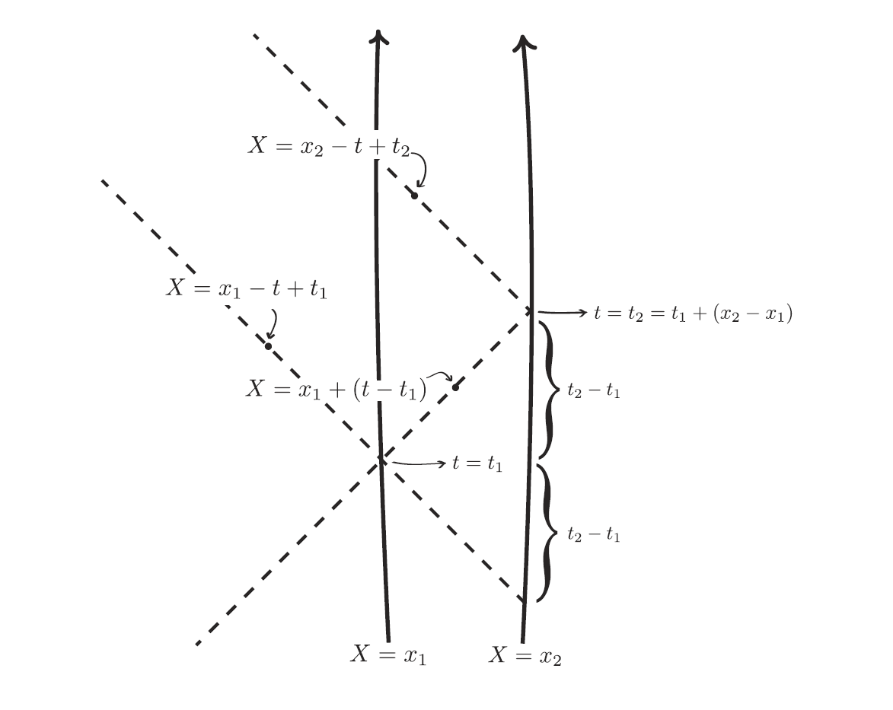
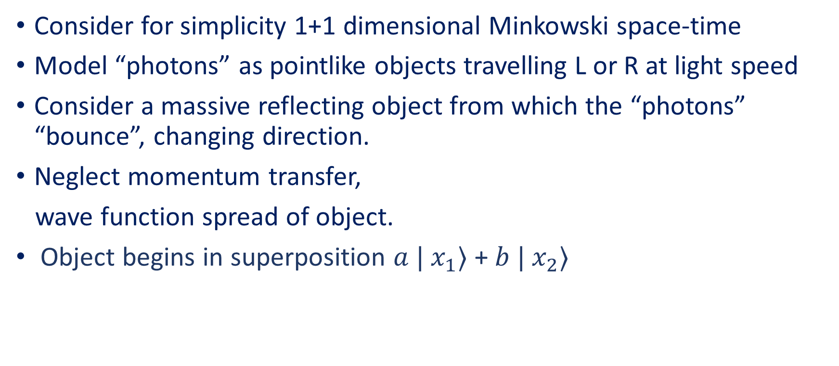
A cartoon version
Consider for simplicity 1+1 dimensional Minkowski space-time
Model “photons” as pointlike objects travelling L or R at light speed
Consider a massive reflecting object from which the “photons” “bounce”, changing direction.
Neglect momentum transfer,
wave function spread of object.
Object begins in superposition $a | x_{1}⟩$ + $b | x_{2}⟩$
Thanks to Jeremy Butterfield
and Bryan Roberts for diagram

Slide 10

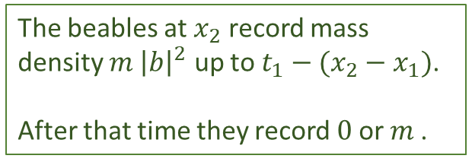

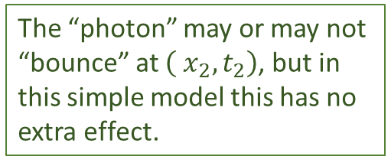

A cartoon version (cont.)
Object, mass $m$, begins in superposition $a | x_{1}⟩$ + $b | x_{2}⟩$
One incoming “photon” from each direction, modelled by lightlike rays with bounces.
The “photon” may or may not “bounce” at $\left( x_{2}, t_{2}\right)$, but in this simple model this has no extra effect.
Measurement of t$he$“photon” at late times shows that it either did or didn’t bounce left at $\left(x_{1}, t_{1}\right).$
Before $t_{1}$ the beables at $x_{1}$ record mass density $m | a {\left.​\right|}^{2}$.
After $t_{1}$, they record $m$or $0$, i.e. definite presence or absence of object.
The beables at $x_{2}$ record mass density $m {\left|b\right|}^{2}$ up to $t_{1}−(x_{2}−x_{1})$.
After that time they record $0$or $m$.

Slide 11
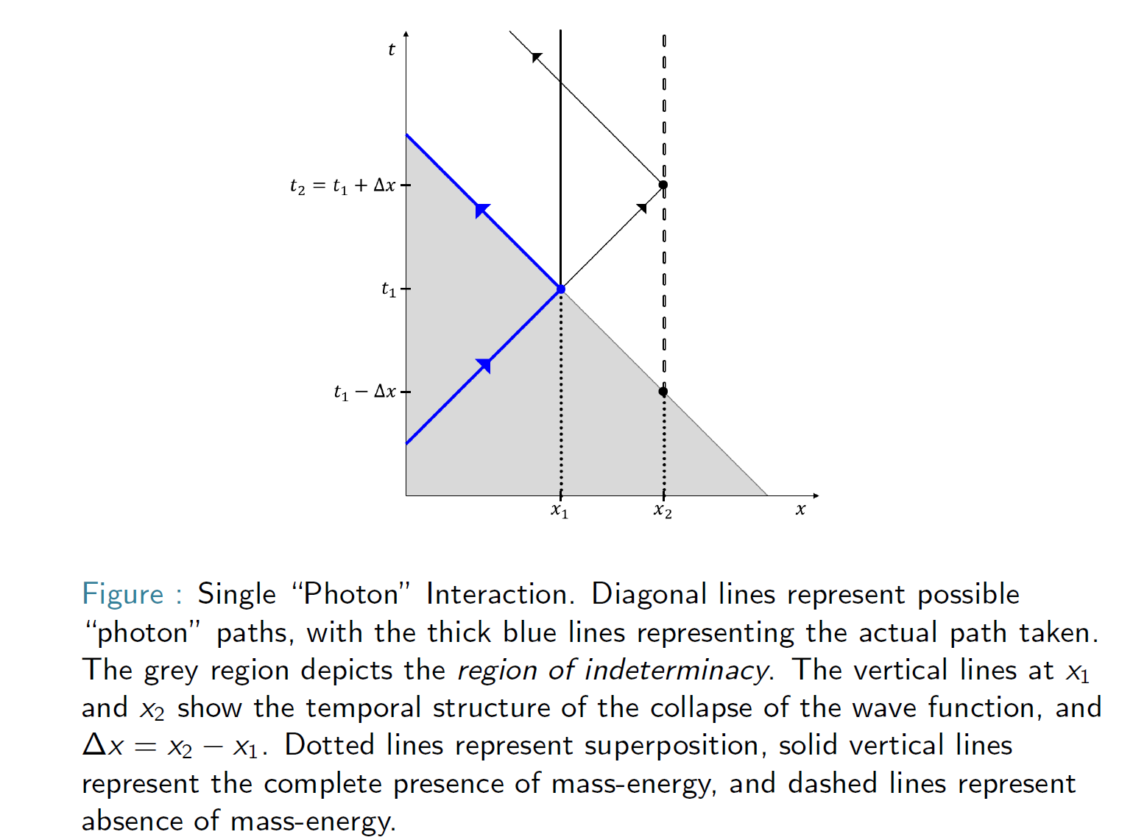


Slide 12
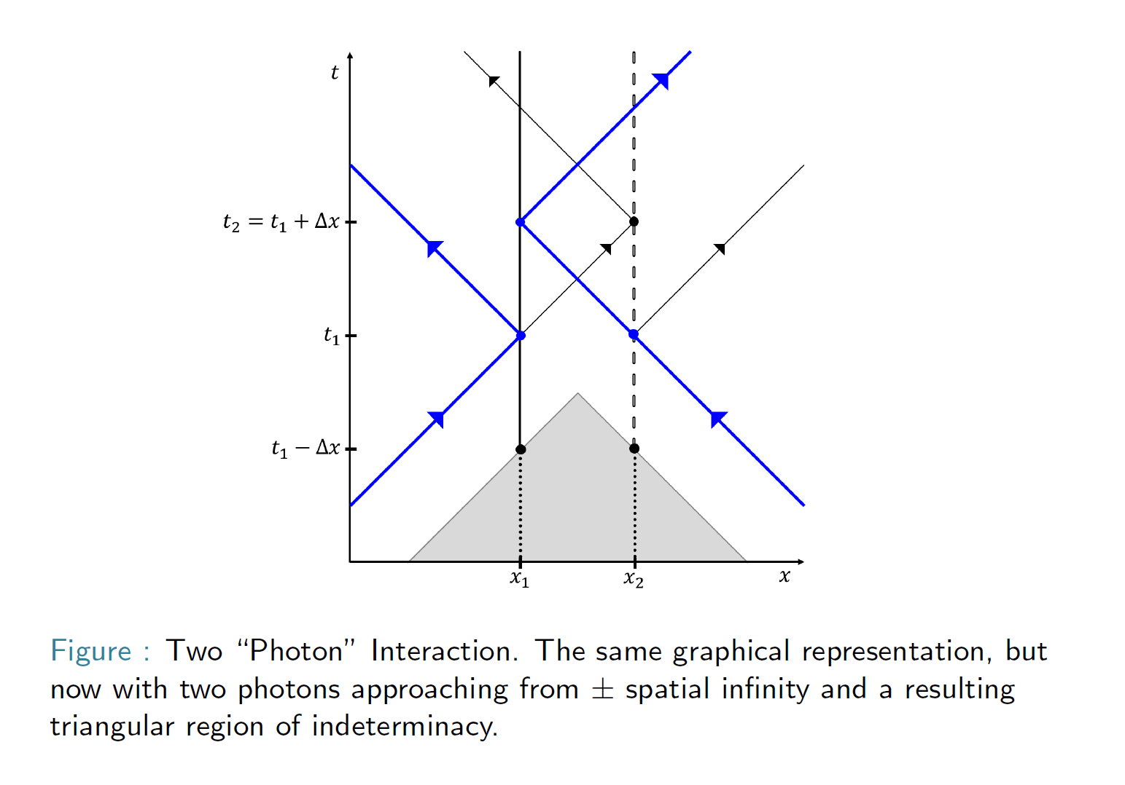
Thanks to Jeremy Butterfield
and Brendan Marsh for diagram

Slide 13
Somewhat more realistic models
(AK, Phys. Rev. A 96, 062121 (2017))
We can model systems that absorb or emit one or several photons using multi-photon wave mechanics.
We need a model of photon measurement in position space.
For illustrations we use the single photon and multi-photon wave function formalism developed by Sipe, Bialynicki-Birula, Smith-Raymer and others.
For these we suppose a fictitious late time “photon position measurement” given by the position space Born rule for the photon wave function.

Slide 14









Postulates for Photon wave function models
We take our final hypersurface $S_{T}$to be given by t=T for large T
We suppose a single idealized fictitious “measurement” of photon positions on $S_{T}$ with Born rule distribution given by the multi-photon wave function. Our “outcomes” are “clicks” at positions $x_{1}, …, x_{N}$ .
Final hypersurface of constant $T, T→∞$
$$x_{1}$$
$$x_{2}$$
$$x_{N}$$
Outcomes used in calculation
of beables at $x$
Outcomes used in calculation
of beables at $x$
$$x$$
$$S_{0}$$

Slide 15



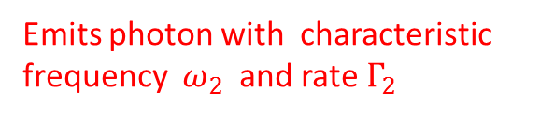


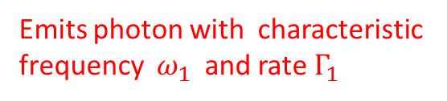
Example: two level cascade decay
An atom is introduced at $(x,t)$= (0,0) in a level two excited state, which decays via a level one excited state to the ground state
We find the probability of detecting a single photon at time $T$ and radial distance $r_{1}>\left(T−t\right)c$ to be $(1 −e^{\left\{−Γ_{1}t\right\}}$)
The probability of detecting a second photon at $r_{2}<r_{1}$ is $\left( 1 – e^{\left\{− Γ_{2}\frac{\left( r_{2} – r_{1} \right)}{c} \right\}}\right)$
These results are independent of T: we have an asymptotically well defined prediction from the model. The atom energy beables transition at some define time (within a few multiples of $Γ_{1}^{\left\{−1\right\}}$) from 2nd excited to 1st $;$and at a later definite time (within a few multiples of $Γ_{2}^{\left\{−1\right\}}$) from 1st to ground. The times are randomly determined by final photon detection locations.
Level 2
Emits photon with characteristic frequency $ω_{1}$and rate $Γ_{1}$
Level 1
Emits photon with characteristic
frequency $ω_{2}$and rate $Γ_{2}$
Ground

Slide 16
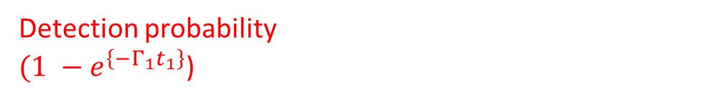
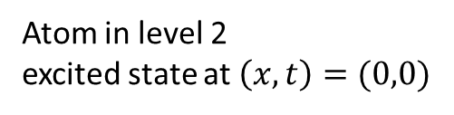
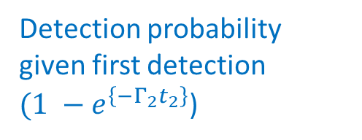
Detection probability given first detection
$(1 −e^{\left\{−Γ_{2}t_{2}\right\}}$)
Detection probability
$(1 −e^{\left\{−Γ_{1}t_{1}\right\}}$)
Time T hyperplane
($0,t_{1}+t_{2}$)
($0,t_{1}$)
Atom in level 2
excited state at $\left(x,t\right)=(0,0)$

Slide 17
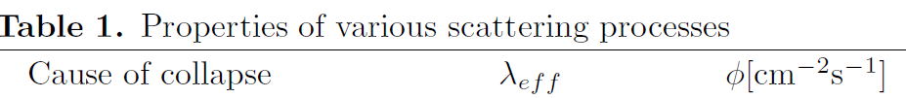
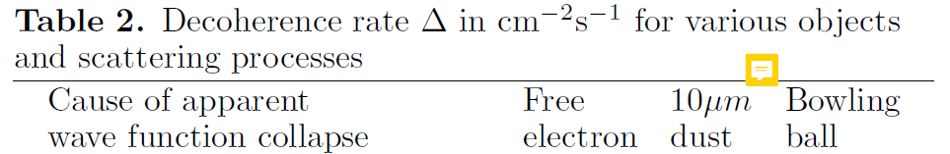
Key points for more realistic discussion
Real mesoscopic systems in familiar environments encounter extremely high photon flux.
Once photons escape the environment of Earth, opacity is low; lower once they escape the galaxy (Davies-Twamley (1993) estimate ~0.02 for the latter for optical wavelengths).
Intuition: a significant proportion propagate to the asymptotic future with negligible scattering. Careful analyses still needed.
From Tegmark (1993)

Slide 18
Key points for more realistic discussion
Real mesoscopic systems in familiar environments encounter extremely high photon flux.
Intuition is thus that decoherence rates are a good proxy for “actualization rates” in this model, up to some orders of magnitude, when not shielded. Good estimates of rate suppression still needed.
From Tegmark (1993)
From Tegmark (1993)

Slide 19
Key points for more realistic discussion
Real mesoscopic systems in familiar environments encounter extremely high photon flux.
Intuition is thus that decoherence rates are a good proxy for “actualization rates” in this model, up to some orders of magnitude, when not shielded. In buildings, underground, … rates may be much lower.
From Tegmark (1993)
From Tegmark (1993)

Slide 20
Another disclaimer and problem
No claim here that the position space Born rule for the photon wave function correctly describes actual photon measurements in photodetectors or is fundamentally correct.
It is a placeholder for a fully satisfactory model of measurement in QED. But it does give physically sensible answers in the contexts in which we use it.
Need a rigorous treatment of asymptotic measurements of the
radiating electromagnetic field in:
  Minkowski space (for non-gravitational version)
  de Sitter space (for more realistic cosmological version)
The measurements don’t need to involve naïve photon counting, but
need to be sufficiently localised to align with the intuitions it gives.

Slide 21

Problem: is this ontology consistent with conscious perception?
Humans report conscious perceptions of events within ~50-100ms of light reaching the retina.
This should hold true for perceptions of a few photons (maybe even one) in a superposition of
macroscopically distinct paths: we expect to see a small flash of light in one location or another.
If the ontology of effective collapse is aligned with conscious experience, this requires effective collapse within ~50-100ms of photon(s) hitting retina.
photon source
beam splitter
Notes:
r

Slide 22

How long does it take for a photon or graviton record of perception to be created (and forever stay) outside the future light cone?
light cone
$$Δt= ?$$
time
source
beam splitter
space

Slide 23





Or, for models with no light cone condition: how long does it take for a photon or graviton record of conscious perceptions to be permanently created (anywhere)?
light cone
$$Δt= ?$$
time
source
beam splitter
space

Slide 24
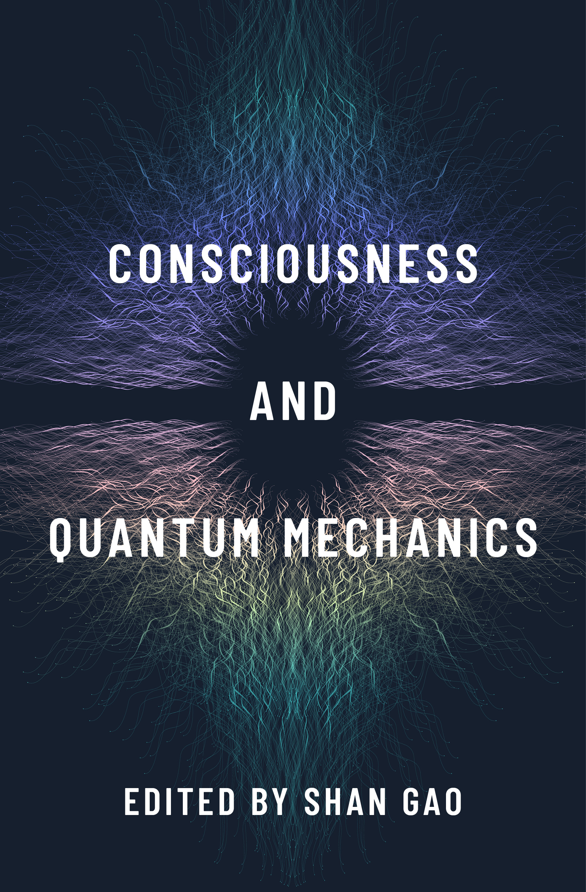
Analysing perception-related decoherence
Related questions arise in GRWP dynamical collapse models: there are some detailed analyses (e.g. Aicardi et al., Bassi et al.) but i.m.o. (see AK 2022) not yet complete consensus on lower bounds on collapse rates.
See e.g. Aicardi et al., Foundations of Physics Letters, 4(2):109-128, 1991.
Bassi-Deckert-Ferialdi. Europhysics Letters, 92(5):50006, 2010.
AK, Perception Constraints on Mass-Dependent Spontaneous Localization
arXiv:1806.10396,
in Consciousness and Quantum Mechanics, S. Gao (ed.),
Oxford University Press (2022).
Related questions also arise in Diosi-Penrose models:
analyses would be good.

Slide 25
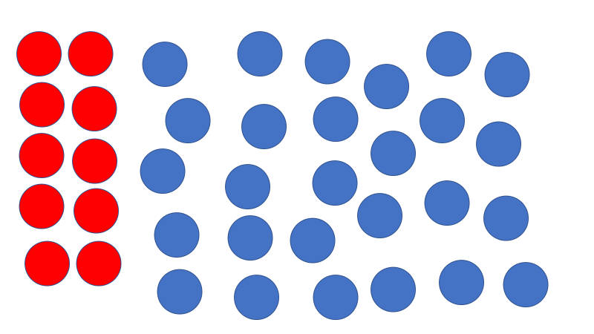
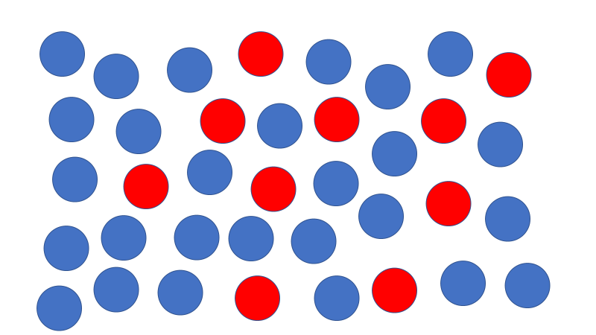
Analysing perception-related decoherence: problems
All discussions of perception collapse times in collapse models are complicated by:
complexity of intracellular biochemistry and physics and of brain functions.

Slide 26





Analysing perception-related decoherence: problems
All discussions of perception collapse times in collapse models are complicated by:
complexity of intracellular biochemistry and physics and of brain functions.
cumulative decoherence as interactions propagate.

Slide 27
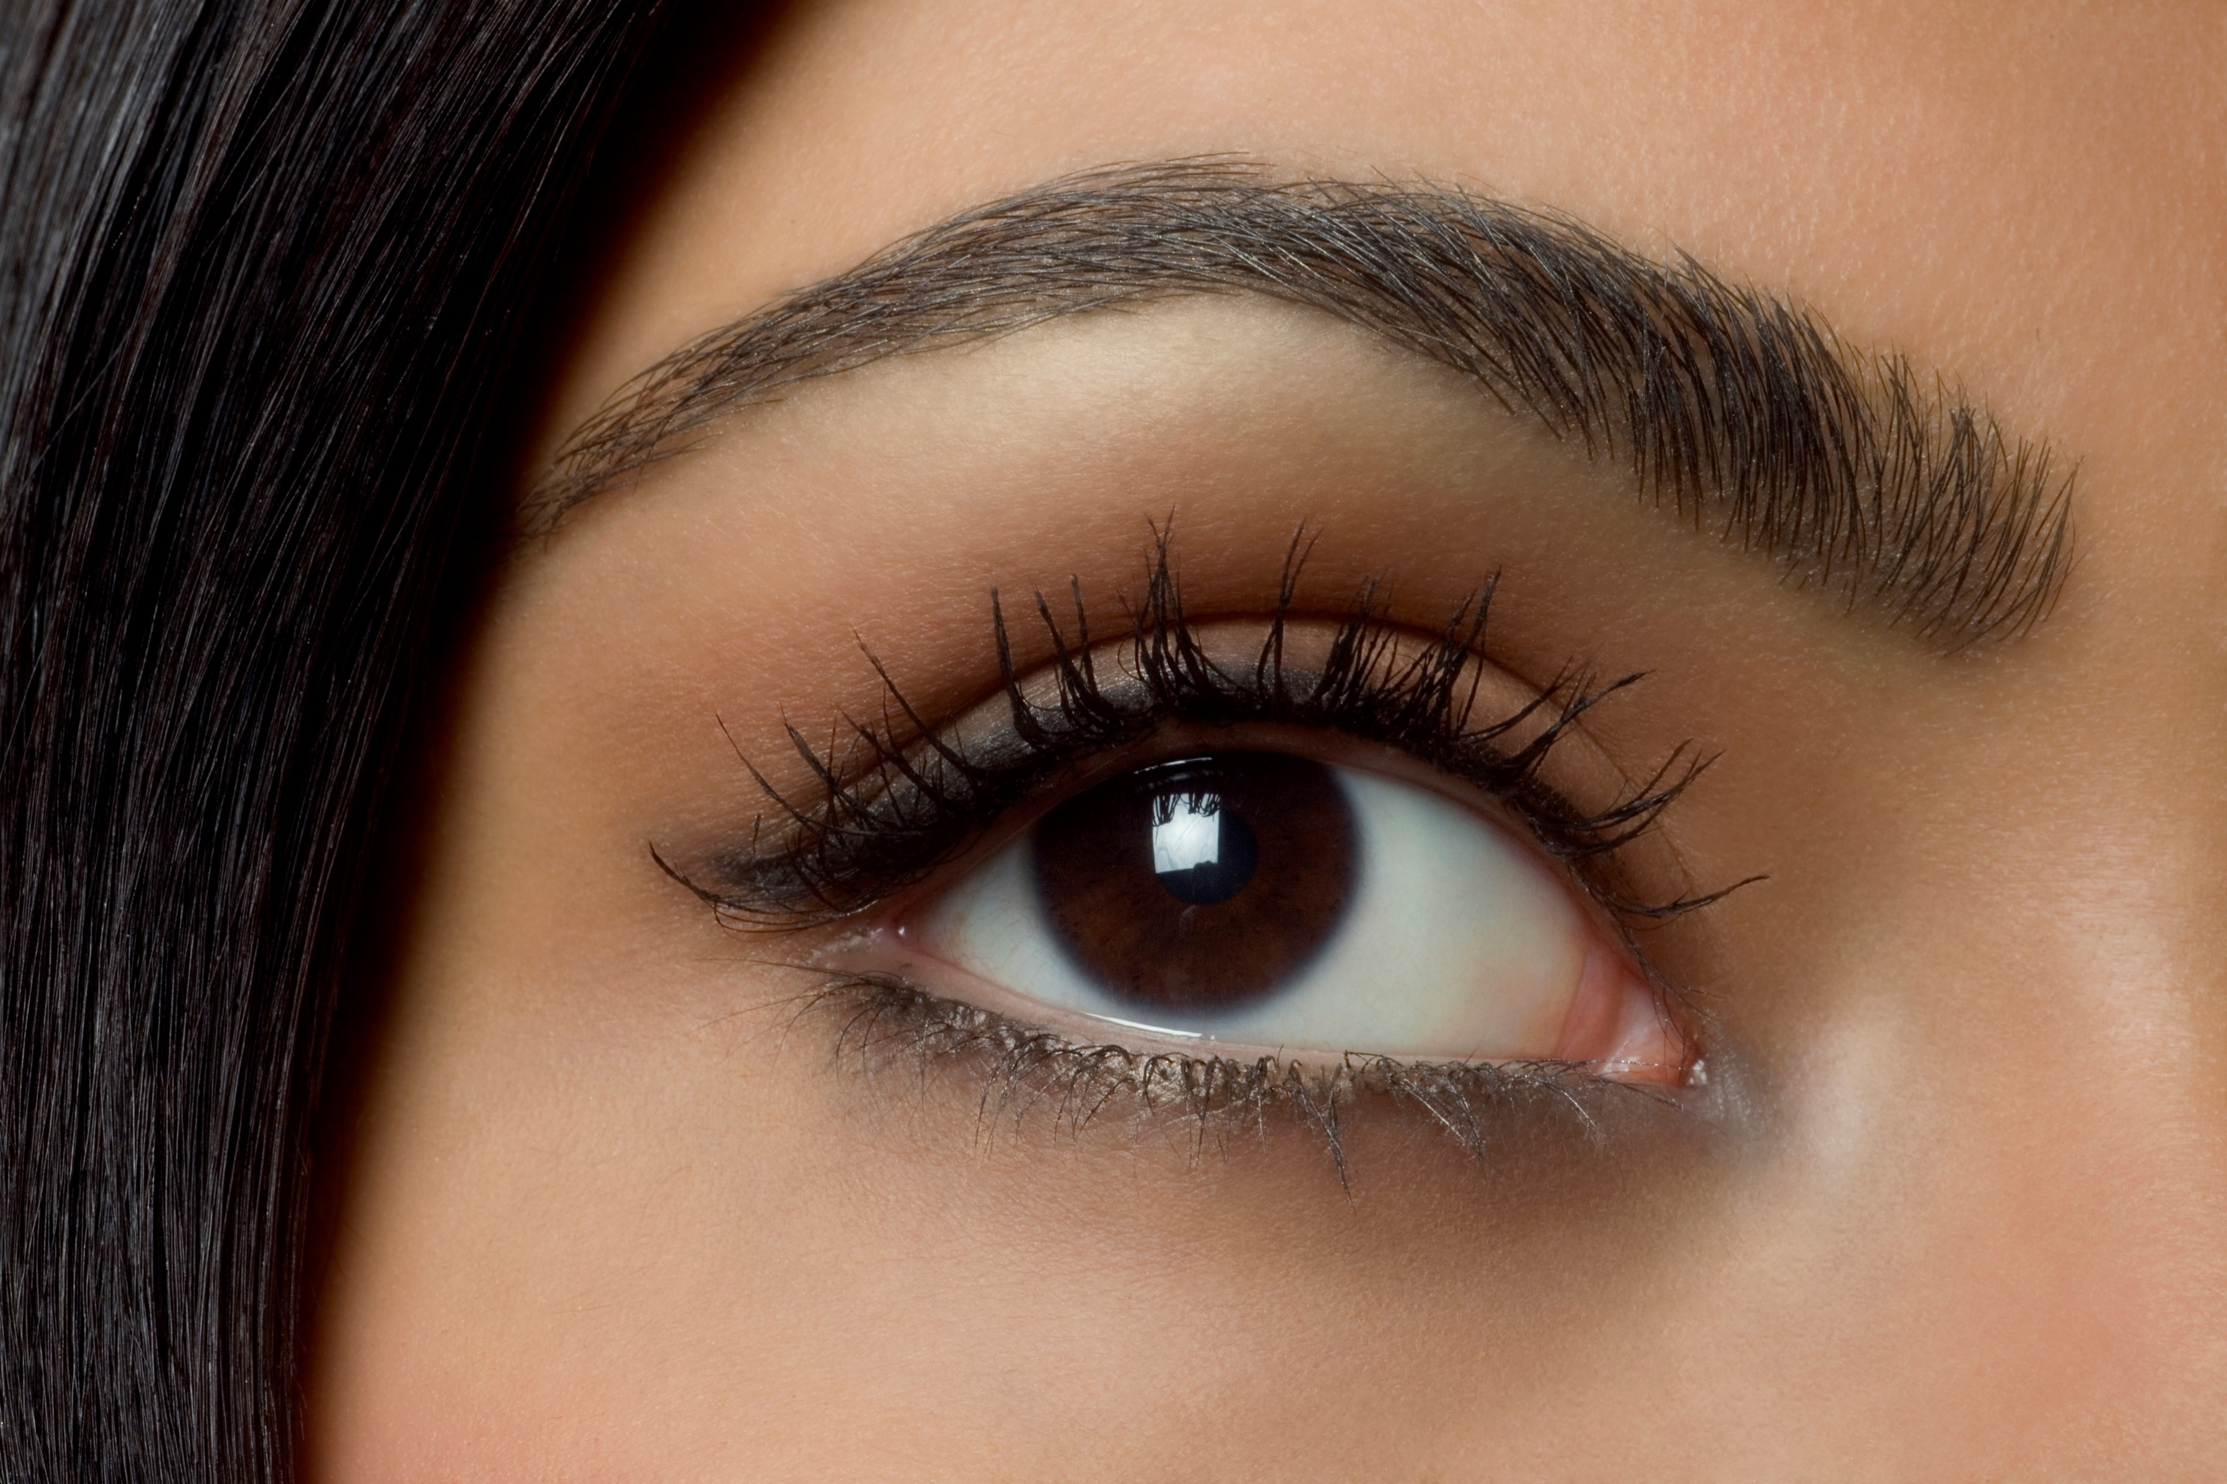
Analysing perception-related decoherence: problems
All discussions of perception collapse times in collapse models are complicated by:
complexity of intracellular biochemistry and physics and of brain functions.
cumulative decoherence as interactions propagate.
possibility that physiological responses* (tiny muscle movements, raised heartbeat ….) could produce collapse in required time even if brain processing does not.
*may be involuntary, unconscious
and tiny on human scales -- but
still swiftly create a large e/m or
gravitational field record

Slide 28
Analysing perception-related decoherence: problems
All discussions of perception collapse times in collapse models are complicated by:
complexity of intracellular biochemistry and physics and of brain functions.
cumulative decoherence as interactions propagate.
possibility that physiological responses (tiny muscle movements, raised heartbeat ….) could produce collapse in required time even if brain processing does not.
Additional complication for late-time photodetection models:
Need to model propagation of photons through brain, skull, (maybe) rock, atmosphere, interstellar medium.
Late-time gravitational field measurement models:
Fewer propagation issues: few if any natural gravitational mirrors, absorbers intervene
But brain events produce v weak effects; estimates are hugely model-dependent

Slide 29
Aligning ontology and consciousness: questions
Arguably* a realist theory is required to give an ontology that reflects human perception times in normal circumstances.
*This is debatable (and debated!): there is a spectrum of options. But it’s at minimum a natural condition and a valuable constraint on models.

Slide 30
Aligning ontology and consciousness: questions
Arguably a realist theory is required to give an ontology that reflects human perception times in normal circumstances.
Is it reasonable to require it does so in all circumstances?
Note that similar questions arise for IIT and other theories aiming to characterise consciousness.
We might require a good theory to characterise human consciousness in typical evolutionary environments.
But we might (?) accept a sufficiently parsimonious theory that works in typical environments but fails in unusual or novel circumstances.

Slide 31

Aligning ontology and consciousness: questions
Arguably a realist theory is required to give an ontology that reflects human perception times in normal circumstances.
Is it reasonable to require it does so in all circumstances?
Locked-in syndrome patients?

Slide 32

Aligning ontology and consciousness: questions
Arguably a realist theory is required to give an ontology that reflects human perception times in normal circumstances.
Is it reasonable to require it does so in all circumstances?
Locked-in syndrome patients?
Humans surrounded by absorbers (deep mines, Faraday cages)?

Slide 33
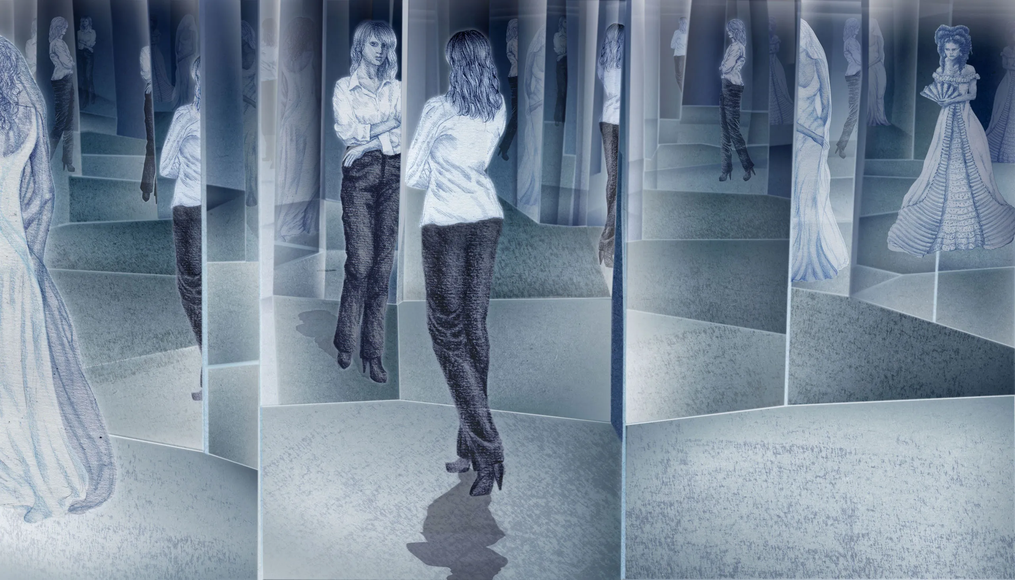
Aligning ontology and consciousness: questions
Arguably a realist theory is required to give an ontology that reflects human perception times in normal circumstances.
Is it reasonable to require it does so in all circumstances?
Locked-in syndrome patients?
Humans surrounded by absorbers (deep mines, Faraday cages)?
Humans surrounded by reflectors (mirror rooms, aliens surrounding Earth by mirror sphere)?

Slide 34





Aligning ontology and consciousness: questions
Arguably a realist theory is required to give an ontology that reflects human perception times in normal circumstances.
Is it reasonable to require it does so in all circumstances?
Locked-in syndrome patients?
Humans surrounded by absorbers (deep mines, Faraday cages)?
Humans surrounded by reflectors (mirror rooms, aliens surrounding Earth by mirror sphere)?
Humans in interference experiments (cf. generalized Wigner’s friend discussions)?

Slide 35
Summary and conclusions:
Constructing an ontology from asymptotic late time e/m or gravitational field using
spacelike data has many arguably attractive features:
Natural within the framework of QM/QFT and SR.
Consistent with predictions of standard quantum theory; not in evident tension with relativity; gives a realistic ontology.
Bell correlations in the ontology ultimately arise via the Born rule on (asymptotic late time) spacelike hypersurfaces
Gives intuitively plausible answers for collapse times/processes in simple models
Raises independently interesting question about the spacelike quantum correlates of conscious perceptions.
Potentially refutable, assuming the ontology must reflect conscious perception times.
Gives useful examples to refine our taxonomy of possible ontologies.

Slide 36
Summary and conclusions:
Many outstanding issues and problems, including:
Needs fully developed theory of asymptotic measurement in QED/standard model/…
Graviton versions are attractive but hard to analyse definitively in the current state of quantum gravity research.
Models are potentially refutable – good! -- but definitive analyses are technically difficult and complicated by questions about how to treat unusual human conscious states (locked-in syndrome patients, humans surrounded by absorbers (deep mines, Faraday cages) or reflectors (mirror walls).
Questions about definitive records of conscious states are independently interesting, so worth analysing.
Versions that don’t restrict to spacelike asymptotic data also interesting to consider
Variations on the spacelike data proposal discussed here also interesting
All versions depend on plausible but unproven asymptotic cosmological hypotheses
All versions open to the “Everettian in denial” critique. The wave function plays a crucial nomic role in the formalism but not in the definition of reality.

Slide 37
What picture of quantum theory and nature emerges if these ideas are on the right lines?
A probabilistic, realist block universe. Compare the picture that would emerge from decoherent histories plus a set selection rule (a la Dowker-AK (1995)).
One “dice roll” defines the beable configuration, hence quasiclassical events, throughout space-time.
The final time measurement is a mathematical device, not a physical event.
We don’t need to think of a dice roll at the end of time retrocausally determining all earlier events.
If we want any metaphor, it's perhaps more natural to think of dice rolled outside of space-time determining the events within.
The beable descriptions of quantum subsystems are part of an irreducible whole. The state vector for an individual system defines a probability distribution over beables. The correlations among these distributions are explained by the final time measurement.
Beables, not the unitarily evolving quantum state, are the physical substrate of consciousness.

Slide 38


Slide 39
How long does it take for an irreversible photon or graviton record to be outside the future light cone?
 | Electromagnetic field record outside future light cone (going to future infinity) within 100ms | Gravitational field record outside future light cone (going to future infinity) within 100ms
From brain processing events on Earth surface | Plausible | Possible, v model-dependent
From brain processing events plus physiological responses on Earth surface | Very plausible | Plausible, still v model-dependent
From brain processing events in deep mine | Needs further analysis | Possible, v model-dependent
From brain processing events plus physiological responses in deep mine | Needs further analysis | Plausible, still v model-dependent
First pass impressionistic summary, using back of the
envelope calculations and estimates of photon
and graviton scattering from
Joos-Zeh, Tegmark.
I hope to elaborate in arxiv/future

Slide 40
What would an interesting solution to the quantum reality problem involve?
Mathematically precise Lorentz covariant definitions of:
a sample space of configurations of “beables”: whatever events, histories, paths, branching structures or other mathematical objects define elements of physical reality.
a corresponding probability distribution
These should apply to closed quantum systems that model relevant features of the universe. (Ideally to the universe, but meanwhile we would like plausible evidence of relevance.)
Given such definitions, we can then postulate that physical reality is described by one randomly chosen configuration drawn from the sample space.
For empirical validation, this should imply quasiclassical physics in realistic models. In particular, it should imply the validity of Copenhagen quantum theory and classical dynamics in their respective domains.

Slide 41





Block universe picture
Theory = $\{$configurations C ; probabilities p(C) $\}$
C
We will assume that it makes sense to consider fundamentally probabilistic theories* of {configuration of beables in space-time} that define reality.
We suppose that doing this in Minkowski space (or other fixed backgrounds) is a good first step, pending a fundamental quantum + gravity theory.
*Are fundamentally probabilistic theories of the universe well-defined?
Do we really know what one-shot probability means?
There is a real debate, but we won’t get into this here.

Slide 42
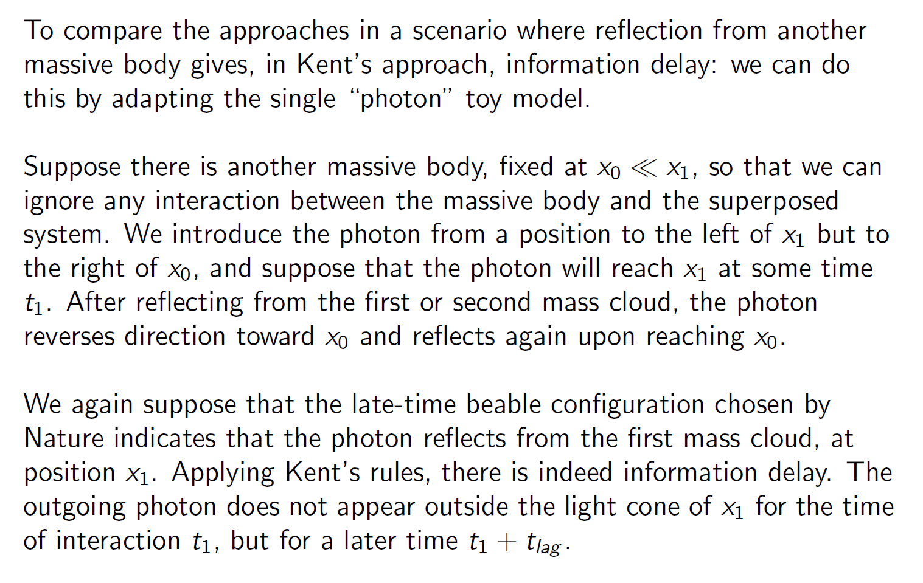
What if the photons are reflected or scattered?
From Butterfield and Marsh, arXiv:1902.01294

Slide 43
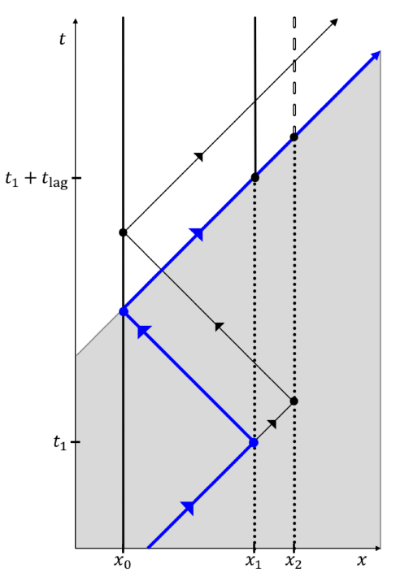
Then against a reflecting
wall on left.
Region of indeterminacy
is extended by the reflection.
Collapse takes place only
across path of photon once it
proceeds to spatial infinity
without further reflections.
Photon bounces first
against superposed
object
Photon emitted to
right by source
Thanks to Jeremy Butterfield
and Brendan Marsh for diagram

Slide 44
Then against a reflecting
wall on left.
Region of indeterminacy
is extended by the reflection.
Collapse takes place only
across path of photon once it
proceeds to spatial infinity
without further reflections.
Photon bounces first
against superposed
object
I would argue this is a feature, not a bug.
Photon emitted to
right by source

Slide 45
Then against a reflecting
wall on left.
Region of indeterminacy
is extended by the reflection.
Collapse takes place only
across path of photon once it
proceeds to spatial infinity
without further reflections.
Photon bounces first
against superposed
object
I would argue this is a feature, not a bug.
But it’s interesting that it would not arise in
a graviton version of the model.
Photon emitted to
right by source

Slide 46
Do they give physically sensible pictures of quasiclassical physics in the model's beables?
Yes, in the simple models we’ve examined.
Yes in general, if some scattered photons approximately follow the light cone from the scattering region -- perhaps with some short delay after further scatterings, absorptions and re-emissions, if the local environment is dense in absorbers and re-scatterers.
Asymptotically, the answer depends on the ultimate fate of the universe.

Slide 47
Some problems for future work …
A full QFT treatment needs to handle infrared divergences.
We need a fully satisfactory treatment of measurements of asymptotic e/m field states in QED and more generally relativistic QFT.
It seems v natural to look at versions of the proposal involving gravitons or other types of gravity theory, but this raises new issues. We need our gravity theory both to define the causal structure of space-time and for causally selected asymptotic measurements of the gravitational field to define the “real world”.

Slide 48

Example: spherical container in superposition collapsed by photon emitted from atom
Imagine a hollow spherical object, which is a perfect absorber, with a small hole through which an atom in excited state $| e 〉$can be introduced. The object begins in a superposition of position states, $| L 〉$(containing the atom) and $| R 〉$ (distant from it).
L
R
At $t=0$the state is $\left( α \right|L 〉+β| R 〉 ) | e 〉$
At late times T the state is $≈α| L^{∗} 〉| g 〉+β| R 〉| g 〉γ\left( r, T \right)$
Ground state
of atom
Wave function of
emitted photon
State of object at L
having absorbed photon

Slide 49

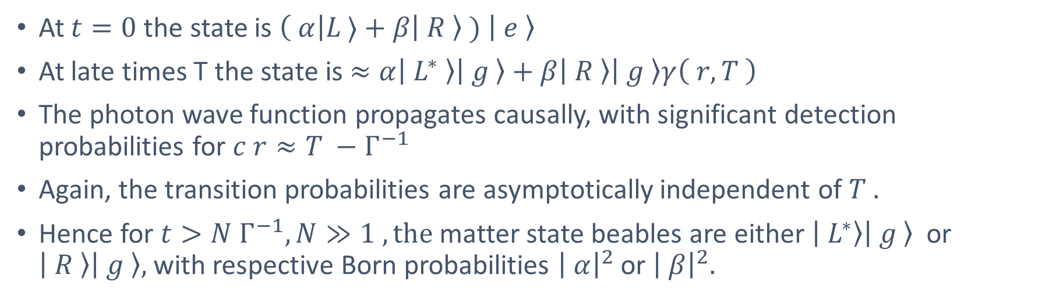
Example: object position collapsed by photon emitted from atom (cont.)
At $t=0$the state is $\left( α\right|L 〉+β| R 〉 ) | e 〉$
At late times T the state is $≈α| L^{∗} 〉| g 〉+β| R 〉| g 〉γ\left( r, T \right)$
The photon wave function propagates causally, with significant detection probabilities for $c r≈T −Γ^{−1}$
Again, the transition probabilities are asymptotically independent of $T .$
Hence for $t>N Γ^{−1}, N≫1 , the$matter state beables are either $| L^{∗}〉| g 〉$ or $| R 〉| g 〉,$with respective Born probabilities ${\left| α\right|}^{2}$ or ${\left| β\right|}^{2}.$
if photon detected, v likely in these regions
Photodetection selects the $\left|R\right\rangle$ component within
a few multiples of $Γ^{−1}$
R

Slide 50
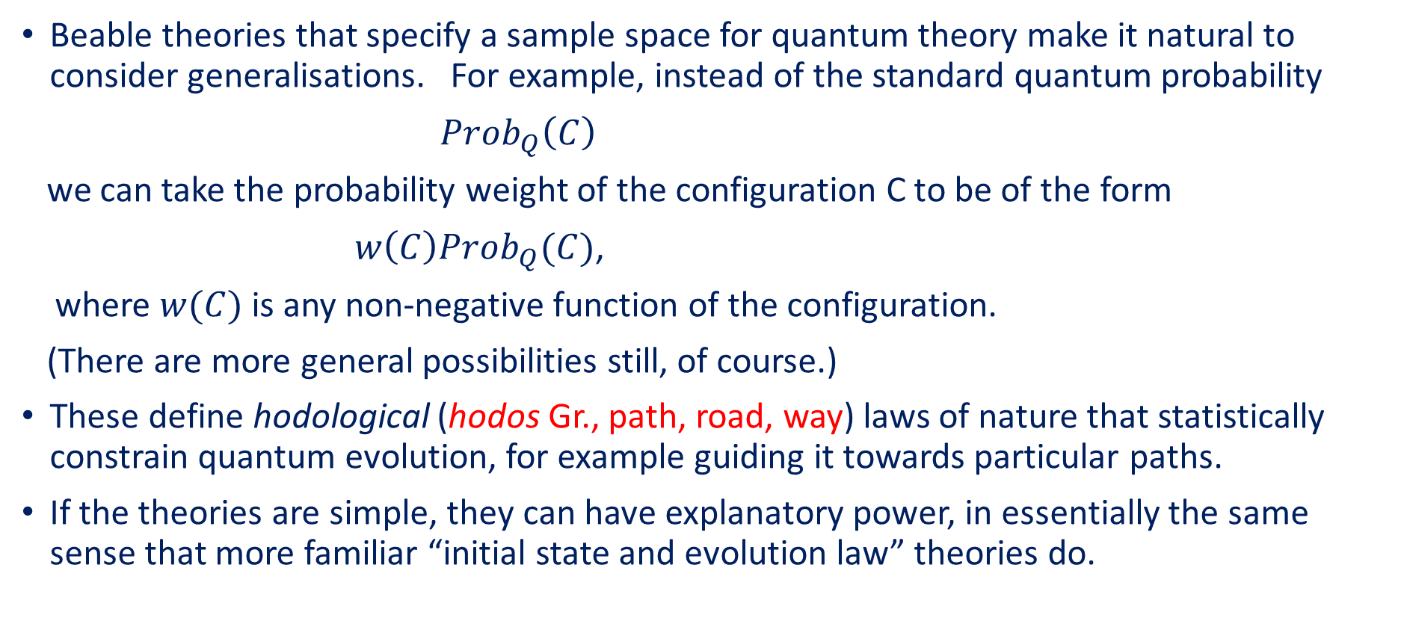
Generalisations of quantum theory
(AK, “Beyond Boundary Conditions: General Cosmological Theories”, Proc. of COSMO-97 (1998), arXiv:0905.0632 ;
AK, “Beable-Guided Quantum Theory: Generalising Quantum Probability Laws”, Phys. Rev. A 87, 022105 (2013);
AK, “Hodology”, arXiv:2004.08223)
Beable theories that specify a sample space for quantum theory make it natural to consider generalisations. For example, instead of the standard quantum probability
$Prob_{Q}\left(C\right)$
we can take the probability weight of the configuration C to be of the form
$w\left(C\right)Prob_{Q}(C)$,
where $w(C)$is any non-negative function of the configuration.
(There are more general possibilities still, of course.)
These define hodological (hodos Gr., path, road, way) laws of nature that statistically constrain quantum evolution, for example guiding it towards particular paths.
If the theories are simple, they can have explanatory power, in essentially the same sense that more familiar “initial state and evolution law” theories do.

Slide 51
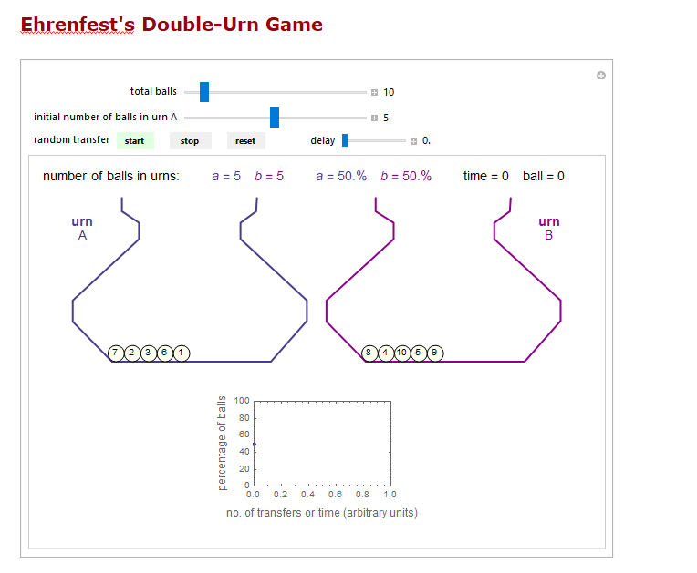
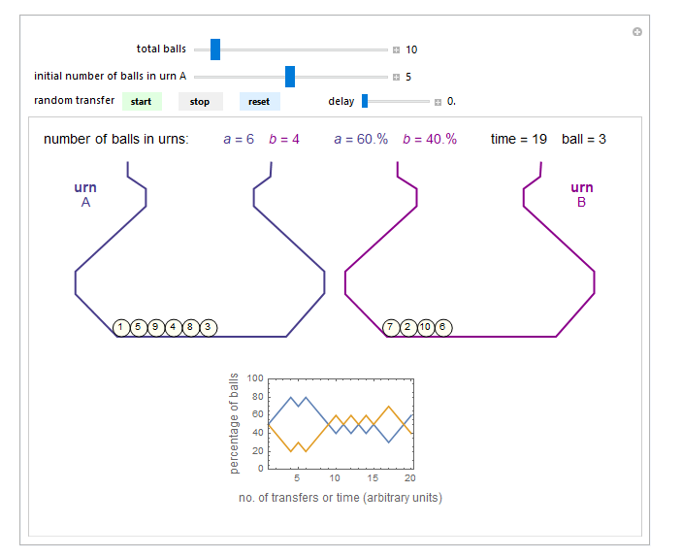
We can illustrate these theories using constrained versions of an Ehrenfest urn model
From Wolfram Demonstrations Project
Initial state
A sample run

Slide 52
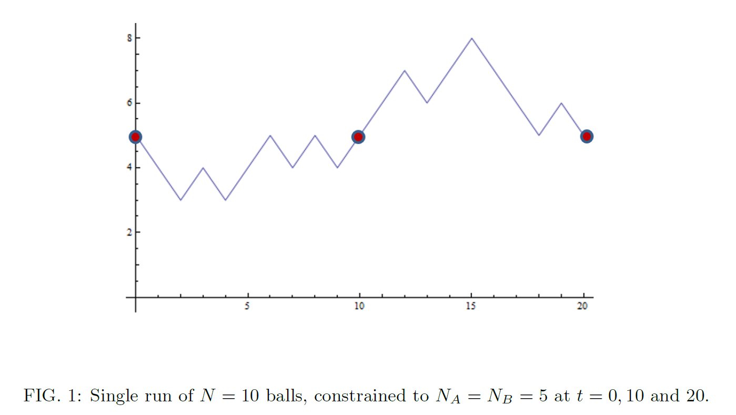
If we normalise so that $w≤1 ,$we can simulate drawing from this probability distribution by repeatedly running and
accepting with probability w, taking the first run we accept as the outcome.
In this simple example, w=0 or 1, so we accept only iff $N_{A}^{10}=N_{A}^{20}=5.$
Generated by
Wolfram Mathematica
(from arXiv:2004.08223)

Slide 53
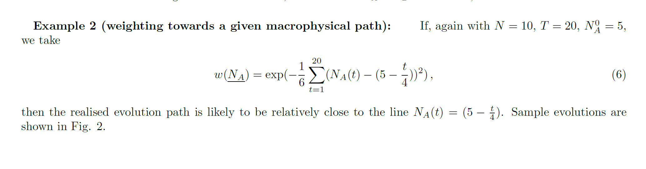
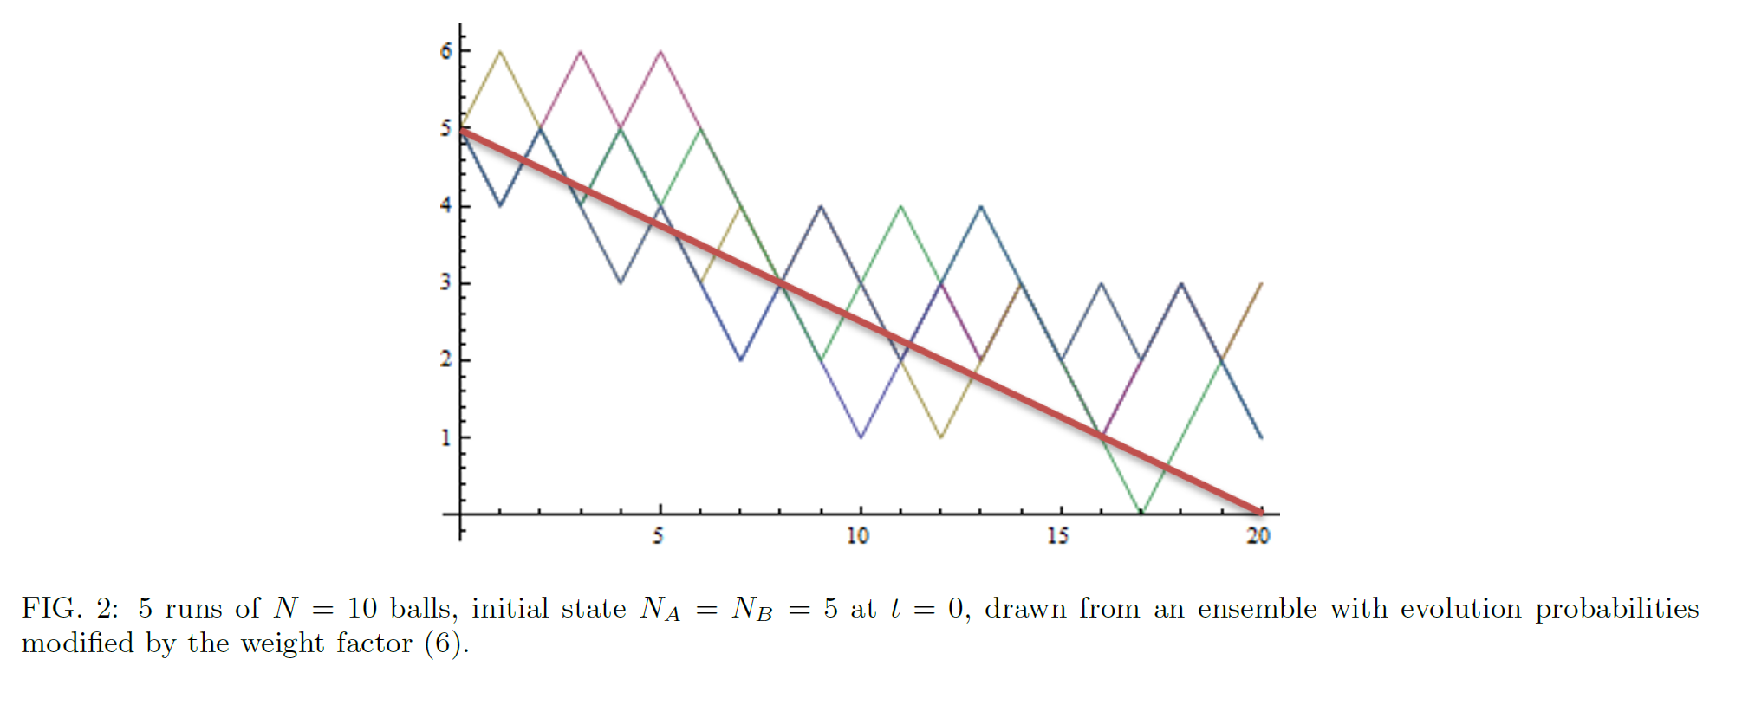
In this example, $w≪1$ for typical runs, so we typically need many runs before accepting.
The accepted runs are far from typical, being strongly biased towards the red line.
Generated by
Wolfram Mathematica
(from arXiv:2004.08223)

Slide 54
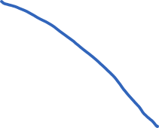
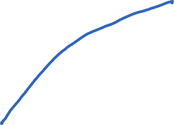

Cosmological implications
Any statistical constraint on a cosmological evolution law can be incorporated into a "beable-guided” version of quantum theory.
For example, given a quantum theory of gravity, one could imagine a weight function that effectively ensures that the universe attains any given sizes, or has any given degrees of inhomogeneity, at a given list of cosmological times – even though these features would be very unlikely given the initial state and Hamiltonian alone.
Beable-guided weights promoting
additional cosmological expansion

Slide 55
Foils or Competitors?
These modified ("beable-guided“ or “hodological”) versions of quantum theory could be taken either as foils, or – for suitably simple w(C) – as genuine competitor theories to standard quantum theory.
If we take ontology seriously, we should take suitably elegant hodological theories seriously as potential competitors. An epiphenomenal ontology seems odd: physical reality is probabilistically determined by the evolving quantum state, but has no effect on it.
Clearly, a baroque hodological theory that essentially recapitulates the data is scientifically useless.
But Solomonoff induction gives a trade-off between elegance and data fitting. A hodological theory HT would be the best scientific explanation of the data if it minimizes
(program length) + (length of the string needed to describe the data given HT)
– i.e. is relatively elegant and fits the data relatively well, compared to any alternative.
At present, our best theories involve initial states and unmodified quantum probability laws. But if they are truly the best theories, it’s because they minimize description length, not because this class of theory is beyond question intrinsically scientifically superior.

Slide 56
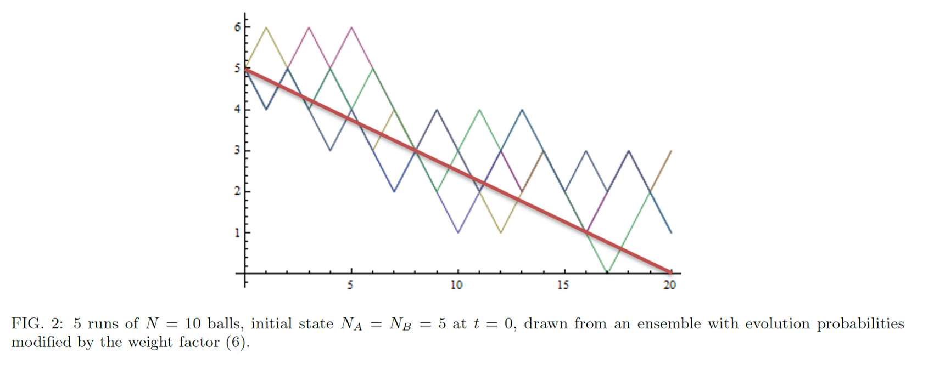
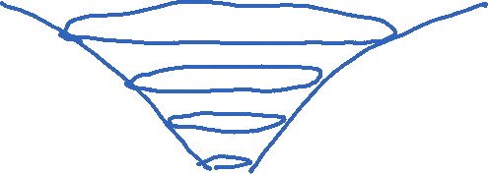
Of course, if we ever find an apparently hodological law, we would look for deeper explanations.
There might be underlying mechanisms and variables we’re missing.
There might be a deeper underlying theory that fits the more familiar paradigm.
But there need not be. Insisting there must be an underlying explanation of a hodological law is no more justified than insisting that there must be an explanation for why the world is described by an initial state and the familiar type of dynamical law (if indeed it is).
That said, we should ask why familiar theory types work so well and any “hodological corrections” (if any appear) are subtle.
Any hodological proposal would thus deserve (and surely get!) intense sceptical scrutiny. But a systematic
search for possible cosmological evidence should still be encouraged.

